Slide 1
DS 7333 – Quantifying the World
Live session - 5
Intro to Trees

Slide 2
Outline
Brief Review
Trees & Forests

Slide 3
Review: (Cross) Validation
Split your data into 3-5 sets (more is fine, but takes time) or partitions
Set aside each set as a test data split, build model on the other sets.
Repeat for each step (in essence build your model 3-5 times)
Average your results
Prevents overfitting

Slide 4
Validation Caveats
Shuffle your data
Make your shuffle repeatable
Lol what? Randomize your data but randomize it in the same way every time?
Yes. Allows your results to be duplicated by peers
But prevents inducement of order/index based splits
If you want an order/index based split, make it a feature.
Balance or weight your classes
Class imbalance becomes a problem around 10:1
“Stratified” k-fold

Slide 5
Sampling….oh, let’s count the ways.
The simple 70/30-split or a 5/10-fold cross validation will account for practically all use cases; I only mention the 70/20/10 for transparency

Slide 6
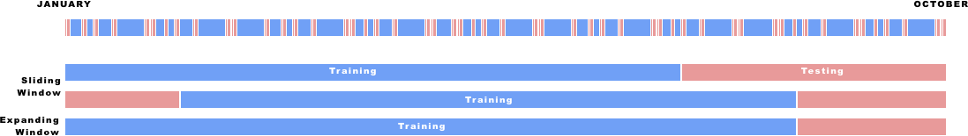
Dealing with ‘temporal’ data can be tricky….see why?
If we used random sampling to train a model impacted by time, we may use the historical ‘future’ to evaluate performance on the historical ‘past’
In data science terminology, that is one component of “data leakage” (i.e., leaking data about the target into your training data)
Ultimately, be super careful when dealing with time-oriented data

Slide 7
Oh yeah, and another note on sampling….
Stratification allows us to maintain our target’s “prevalence” rate throughout our sampling sets (ex. Our target class is equally represented in both the training and testing sets, or throughout the cross validation process)
Sometimes, you may want to include additional strata beyond the target (ex. Demographics) to aid in the creation of equitable and fair models

Slide 8
Metrics: Classification
Accuracy – how many did I get right (in total)?
Precision – how many correct “true predictions” I made divided by how many in total I predicted to be true
Recall – how many correct “true predictions” divided by all true records
F1 – Balanced precision and recall (for positive class)
Type I error (false positive)
Type II error (false negative)
Matthews Correlation Coefficient – balanced accuracy for binary problems

Slide 9
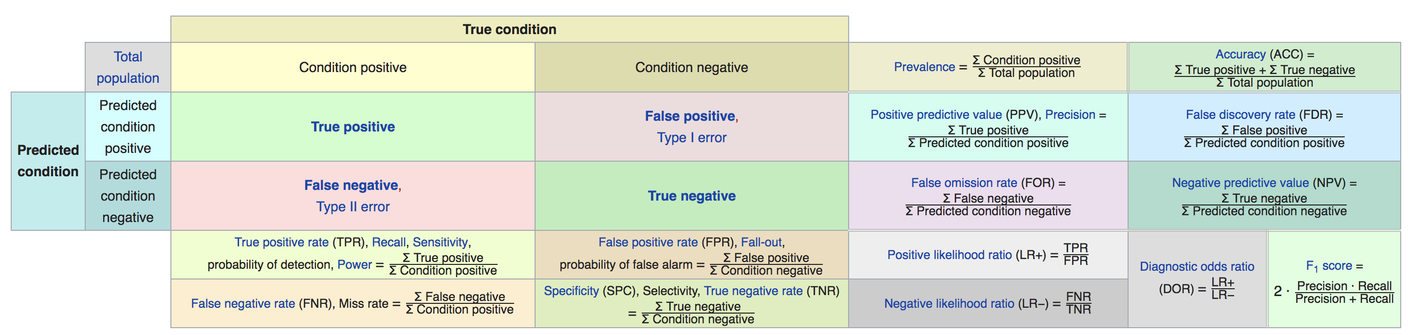
Metrics: Classification (Illustration)
Source: Wikipedia

Slide 10
Metrics: Continuous
Mean Square Error
Emphasizes outliers
Mean Absolute Error
Minimizes outliers

Slide 11
Methods: Unsupervised
Clustering
k-means
Find n number of centers by measuring distance to all points and moving centers around
k-NN (Semi-supervised)
Vote on result based on neighbors

Slide 12
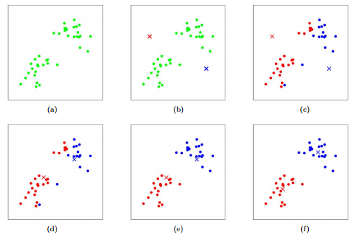
A quick review of Clustering (and one method; k-means) What is it and why is it needed?
“Clustering (in general) is a technique for finding similar groups in data, called clusters. It attempts to group individuals in a population together by similarity, but not driven by a specific purpose. Clustering is often called an unsupervised learning approach, as you don’t have prescribed labels in the data and no class values denoting a priori grouping of the data instances are given. (Source)”
A visual walkthrough
A great narrative
Example: In (a), no clusters are assigned. In (b), two “centroids” (x icon) were randomly placed in the feature space with “cluster” (blue|red) assignments being introduced in (c). Cluster assignment is an iterative process, resulting in the “centroids” being redrawn until the distance to each clusters’ centroid are minimized for each point contained within it (f).

Slide 13
Methods: Supervised
Linear Regression / Gradient Descent
Coefficients are variable importance
Always use regularization
L1 – (Lasso) – variable selection (zeroes out coefficients)
L2 – (Ridge) – some coefficients near zero (but not zero)
Logistic Regression / Gradient Descent
See above!
But with a different loss function

Slide 14
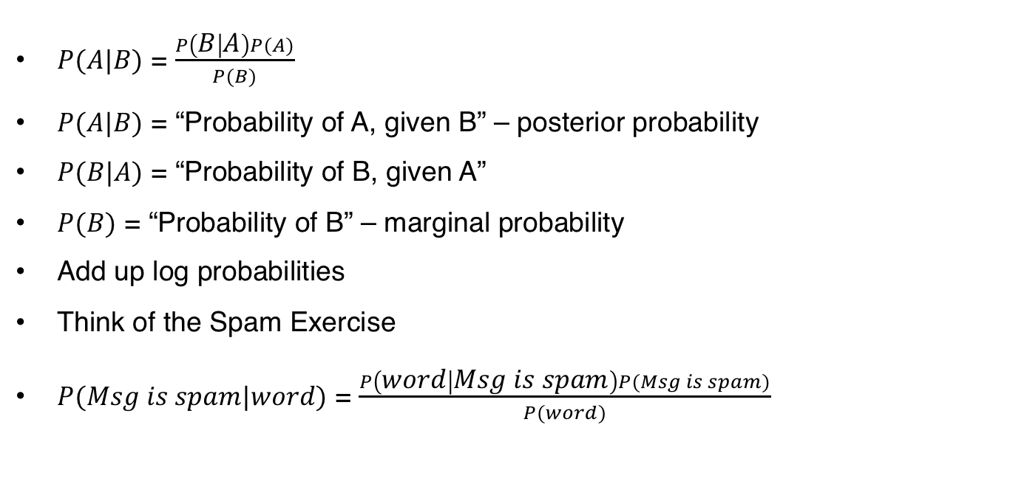
Naïve Bayes
$P(A|B)$ = $\frac{P\left(B | A\right)P(A)}{P(B)}$
$P(A|B)$ = “Probability of A, given B” – posterior probability
$P(B|A)$ = “Probability of B, given A”
$P(B)$ = “Probability of B” – marginal probability
Add up log probabilities
Think of the Spam Exercise
$P(Msg is spam|word)$ = $\frac{P\left(word | Msg is spam\right)P(Msg is spam)}{P(word)}$

Slide 15
Tips and Tricks (General)
Scale your data
-1 to 1
0 to 1
helps when interpreting variable importance
Scale based on variance as well
Ensembles outperform single models
Non-correlated ensembles are better than correlated ensembles
There is no magic formula – “There is no free lunch!”

Slide 16
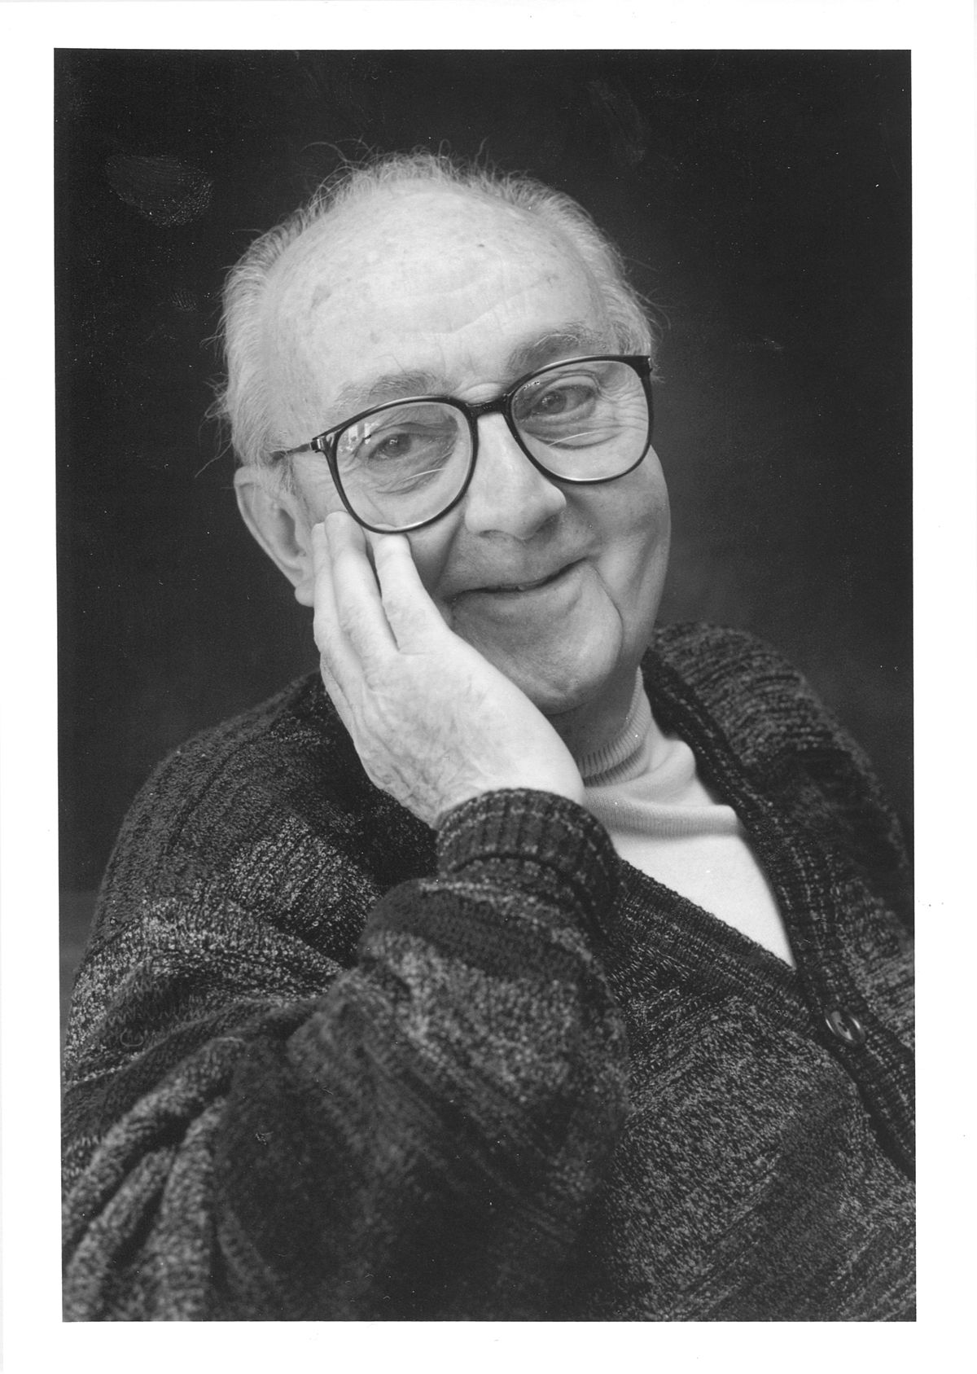
Remember
“All models are wrong
but some are useful.”
George Box, famous statistician

Slide 17
So how do we make a useful model
5-fold cross validation
Regression with L1/L2
Folds are stratified and randomized (unless dealing with temporal data)
Data is scaled for variance/mean
Don’t reinvent the wheel – use packages!
Gradient Descent is slow
Much faster methods to solve/approximate solution
How the problem is solved is less important than what the model says
”It’s the archer, not the arrow"

Slide 18
New arrows made from Trees
Source: DataCamp

Slide 19
Classification & Regression Trees (CART)
Inherently non-linear
Approximate value by a hypercube
2-D version available
Very interpretable
Methods for building trees can be obscure
Linear models are easy to understand/solve
Most people don’t know the “under the hood” methodology for trees

Slide 20
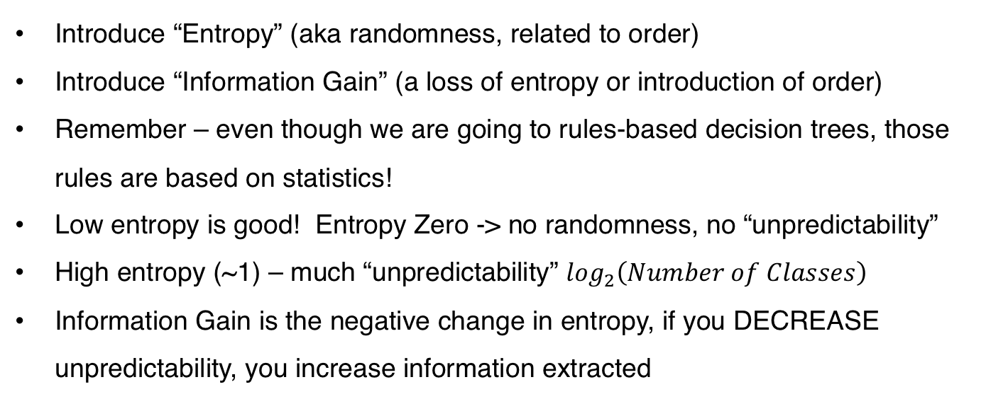
Building a Tree
Introduce “Entropy” (aka randomness, related to order)
Introduce “Information Gain” (a loss of entropy or introduction of order)
Remember – even though we are going to rules-based decision trees, those rules are based on statistics!
Low entropy is good! Entropy Zero -> no randomness, no “unpredictability”
High entropy (~1) – much “unpredictability” $\log_{2}\left(Number of Classes\right)$
Information Gain is the negative change in entropy, if you DECREASE unpredictability, you increase information extracted

Slide 21
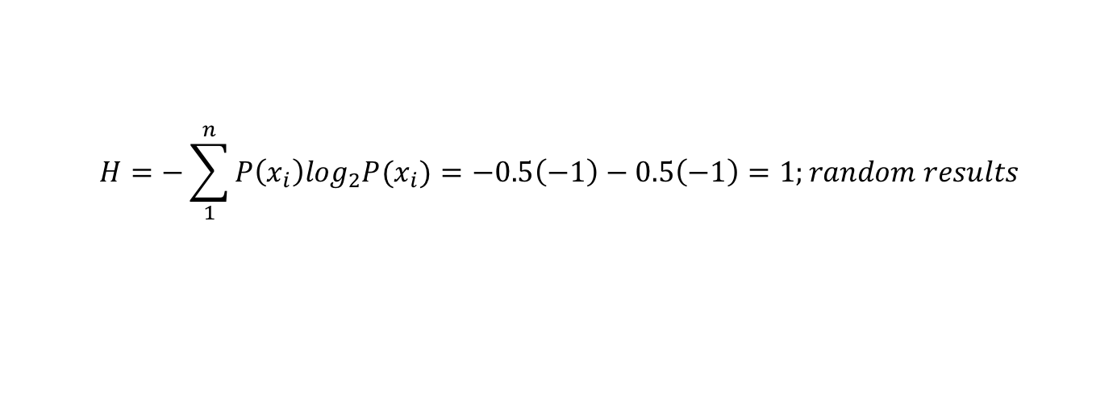
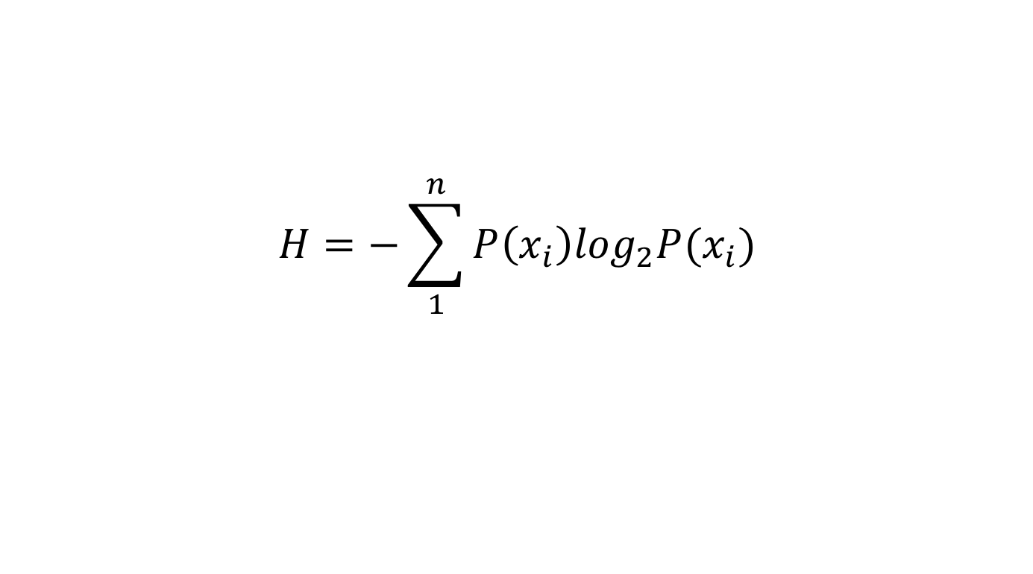
Building a Tree (50/50 example)
$$H=−\sum_{1}^{n}{P\left(x_{i}\right)\log_{2}P(x_{i})}$$
Entropy (H)
$$H=−\sum_{1}^{n}{P\left(x_{i}\right)\log_{2}P(x_{i})}=−0.5\left(−1\right)−0.5\left(−1\right)=1;random results$$
Heads
Tails
Why “Entropy”? The story goes that Claude Shannon didn't know what to call his new information measure, so he asked von Neumann, who said `You should call it entropy ... [since] ... no one knows what entropy really is, so in a debate you will always have the advantage’ (Source)

Slide 22
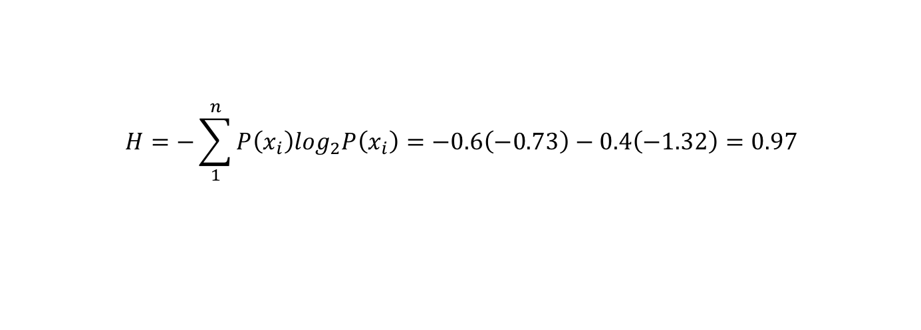
Building a Tree (with a weighted coin)
$$H=−\sum_{1}^{n}{P\left(x_{i}\right)\log_{2}P(x_{i})}$$
Entropy (H)
$$H=−\sum_{1}^{n}{P\left(x_{i}\right)\log_{2}P\left(x_{i}\right)}=−0.6\left(−0.73\right)−0.4\left(−1.32\right)=0.97$$
Heads
Tails
I’ve gained 0.03 bits of information

Slide 23
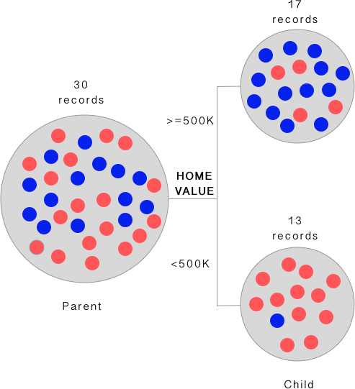
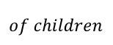
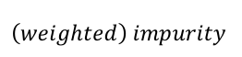
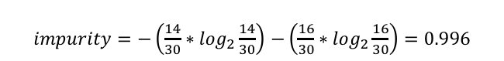
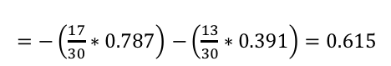
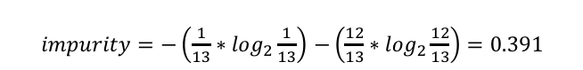
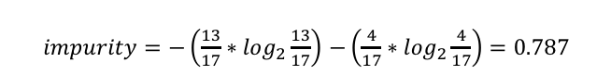
A Visual Example
$impurity=−\left(\frac{13}{17}∗\log_{2}\frac{13}{17}\right)$ $−\left(\frac{4}{17}∗\log_{2}\frac{4}{17}\right)=0.787$
$impurity=−\left(\frac{1}{13}∗\log_{2}\frac{1}{13}\right)$ $−\left(\frac{12}{13}∗\log_{2}\frac{12}{13}\right)=0.391$
$impurity=−\left(\frac{14}{30}∗\log_{2}\frac{14}{30}\right)$ $−\left(\frac{16}{30}∗\log_{2}\frac{16}{30}\right)=0.996$
$$\left(weighted\right) impurity$$
$=−\left(\frac{17}{30}∗0.787\right)$ $−\left(\frac{13}{30}∗0.391\right)=0.615$
$$of children$$
$$information gain=0.996 −0.615=0.38$$

Slide 24
So how do I build a Tree
Recursively partition your data (split your data) and find the maximum REDUCTION in entropy (information gain)
Go through your features 1 by 1 and split them to find the max info gain
The algorithm bins your data
Calculates splits based on the bias; calculates info gain for each split
Picks the split that lowers entropy most (note: surrogacy)
To prevent overfitting, induce rules to govern split criterion
Repeat this procedure until you can no longer increase the info gain by a fixed amount: the Complexity Parameter (see page 24)

Slide 25

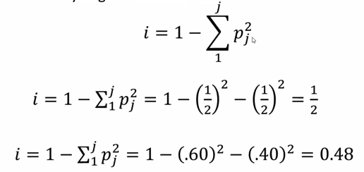
But back in the good old days
Started with “Gini Impurity” (not the Gini coefficient; that is income inequality)
CART uses Gini (same range 0 -> good, 1 -> bad)
Most others use Entropy
98% of the time you get the same model

Slide 26
Time to play with the Iris data
Get the Iris dataset
Get the ’rpart’ package
One parameter to tune – ‘cp’
What is the relationship between cp and your tree size?
Does increasing cp give you MORE or FEWER branches?
Plot your trees

